Slide 1
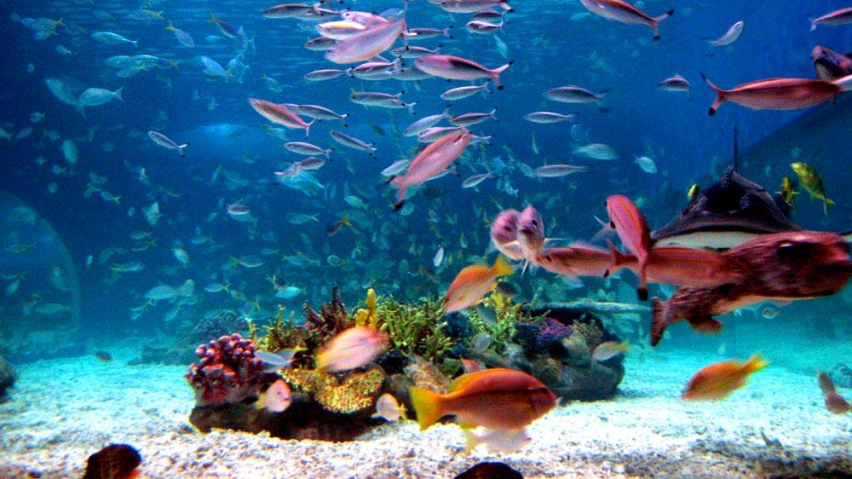
Under the Sea
JFK Consultants, LLC
This Photo by Unknown Author is licensed under CC BY-SA

Slide 2
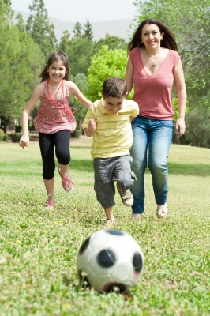
Mommy I love you!
Can you remember some of the fun things you and your mom have done?
What is your favorite thing to do with your mom?

Slide 3
Have you ever been to the beach?
What were some of the things you saw at the beach?
What were some of the things you did at the beach?
Who took you to the beach?
Was it a long trip to the beach?
What mode of transportation did you use to get to the beach?
This Photo by Unknown Author is licensed under CC BY-SA

Slide 4
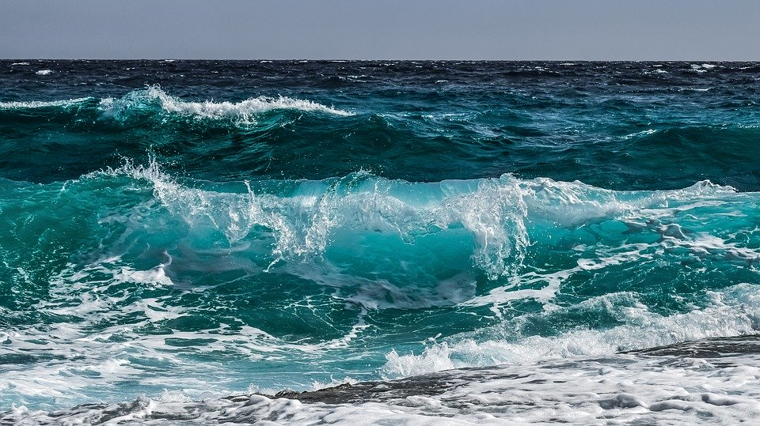
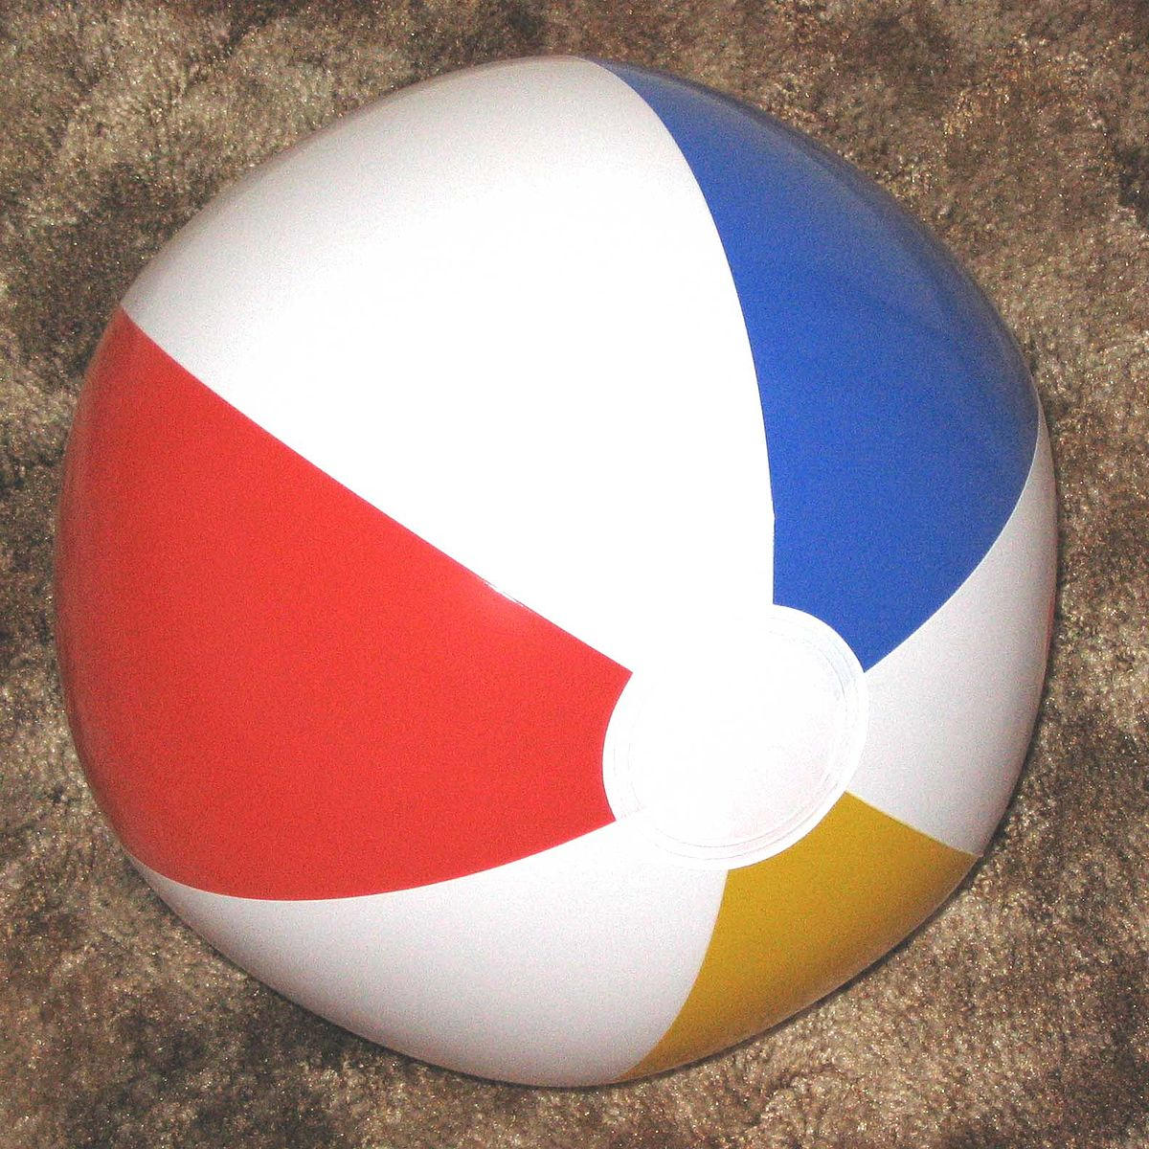
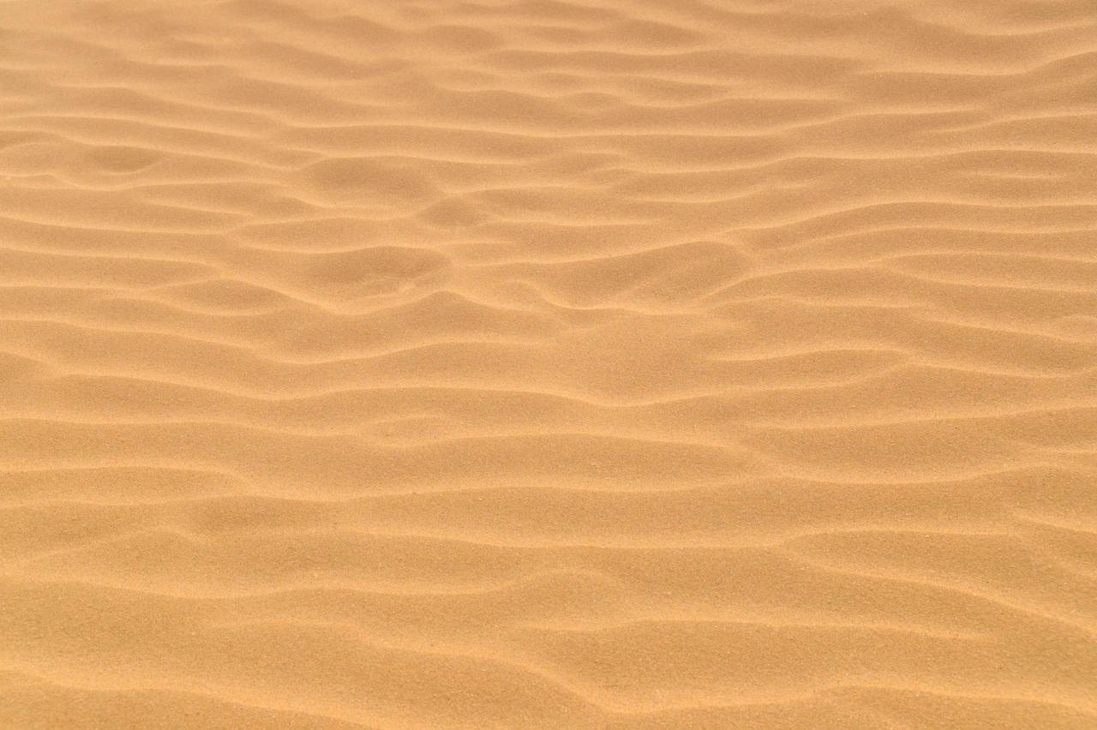
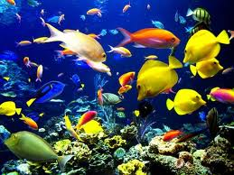
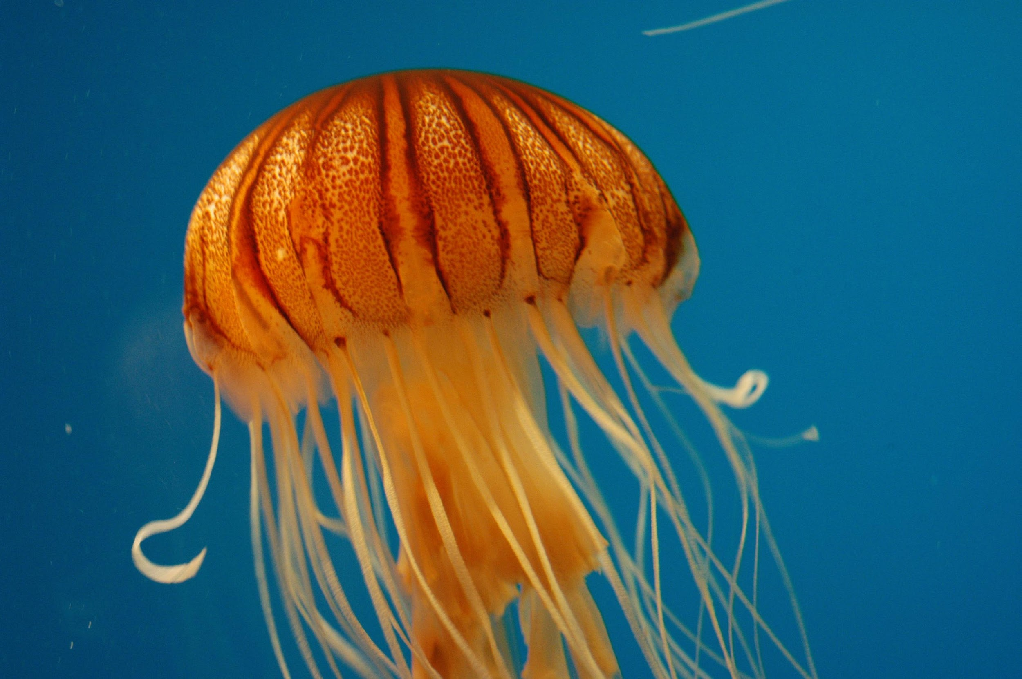
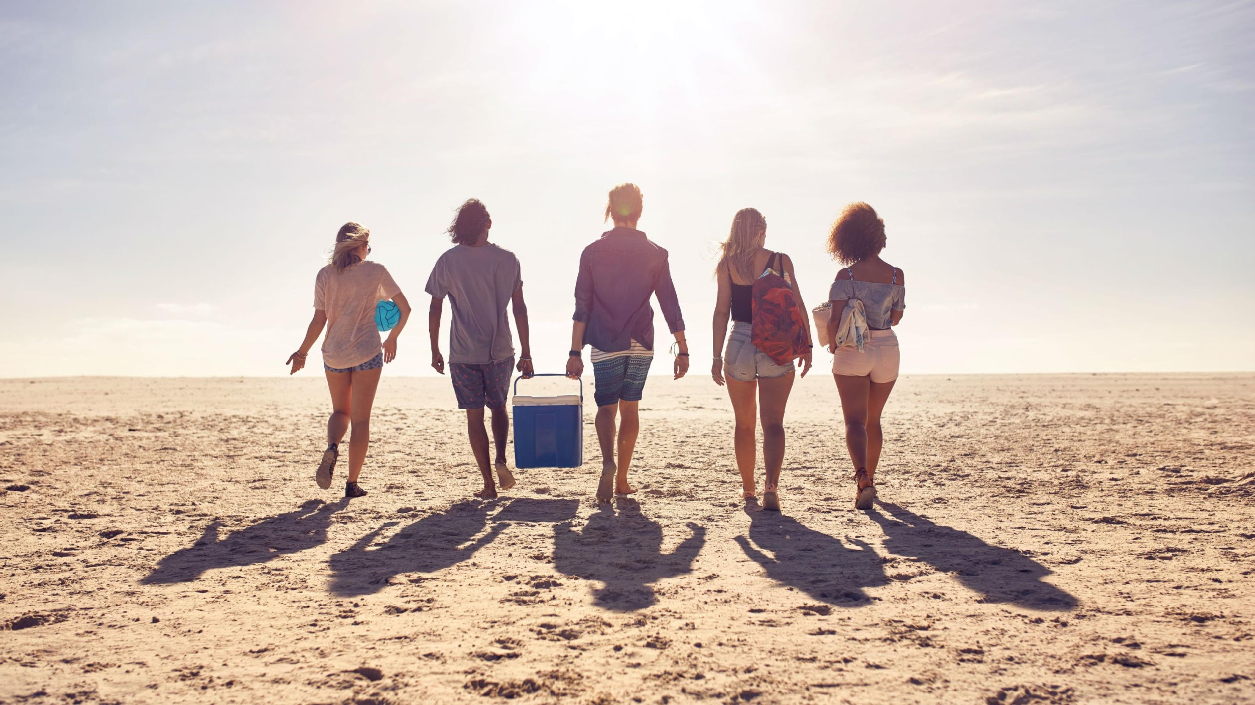
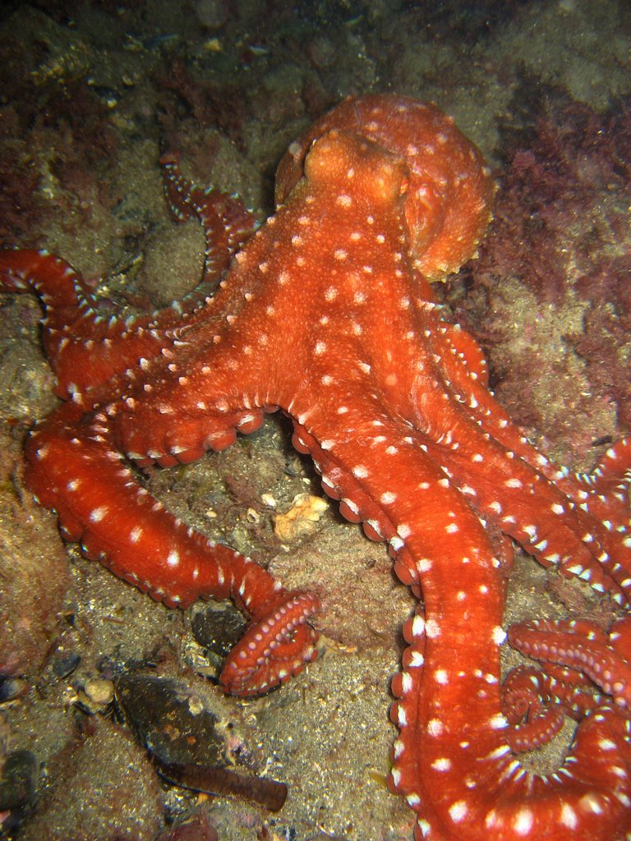
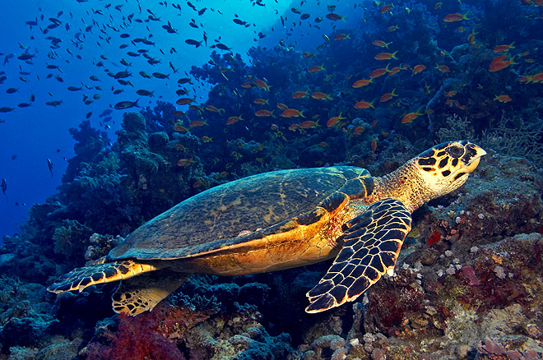
Waves
Beach ball
What’s at/or in the Ocean?
Sand
Animals
People

Slide 5
It’s Story Time
https://www.youtube.com/watch?v=ir4PF70GYQU

Slide 6
Advance Words
It’s time to advance our children’s vocabulary.
This Photo by Unknown Author is licensed under CC BY-SA-NC

Slide 7
Touche’
Used as an acknowledgement during a discussion of a good or clever point made.

Slide 8
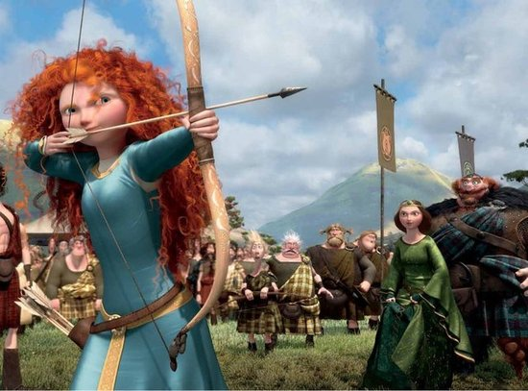
Brave
Ready to face and endure danger or pain; showing courage.

Slide 9
Treasure
A quantity of precious metals, gems, or other valuable objects.

Slide 10
Racing
Any sport that involves competing in a race.

Slide 11
Diving
The sport or activity of swimming or exploring underwater.

Slide 12
Fencing
The sport of fighting with swords.

Slide 13
Book Reflection
Have you ever seen a starfish, hermit crab, or a sea turtle?
Tell the difference between the octopus and the turtle.
Ask the children to describe the animals. (Teachers, listen to the details the children are giving).
If you could be any sea animal, which would it be and why?
What other sea animal do you think can be in the story?

Slide 14
Family Activities

Slide 15
Beach Letter Hunt
Materials Needed:
Play sand
Shells (You can buy bags of them at the dollar store)
Permanent Marker
Shovels/spoons/scoops
1. Write letters of the alphabet on the backs of the shells using the permanent marker. I chose to write all of the lowercase letters of the alphabet. You can write either uppercase or lowercase letters. You can do matching activities. You may also want to include enough letters to spell each child’s name. 2. Pour the sand in your sand table or sensory bin. 3. Bury the shells in the sand.
4. Let the hunt begin!

Slide 16
Under the Sea Playdough
1 cup of salt
1 cup of water
2 cups of flour
1 tablespoon of cooking oil
Kool-Aid (optional)
Directions:
If you want to use food coloring, make sure to mix it with the water before adding it to the other ingredients.
Mix all the ingredients together.
Knead the mixture until it’s doughy.
That’s it!
Now make sea creatures with the playdough!

Slide 17
The Writing Corner
WOW we can write/draw letters and shapes. This week we will practice making a slant line. Here we go!
Tell your child to put his/her pencil at the top of the paper and draw the line slanted or to the side.
Now you should be able to write the following letters, numbers, and shapes.
Letters: E, T, I, F, H, L, N
Numbers: 1
Shapes:

Slide 18
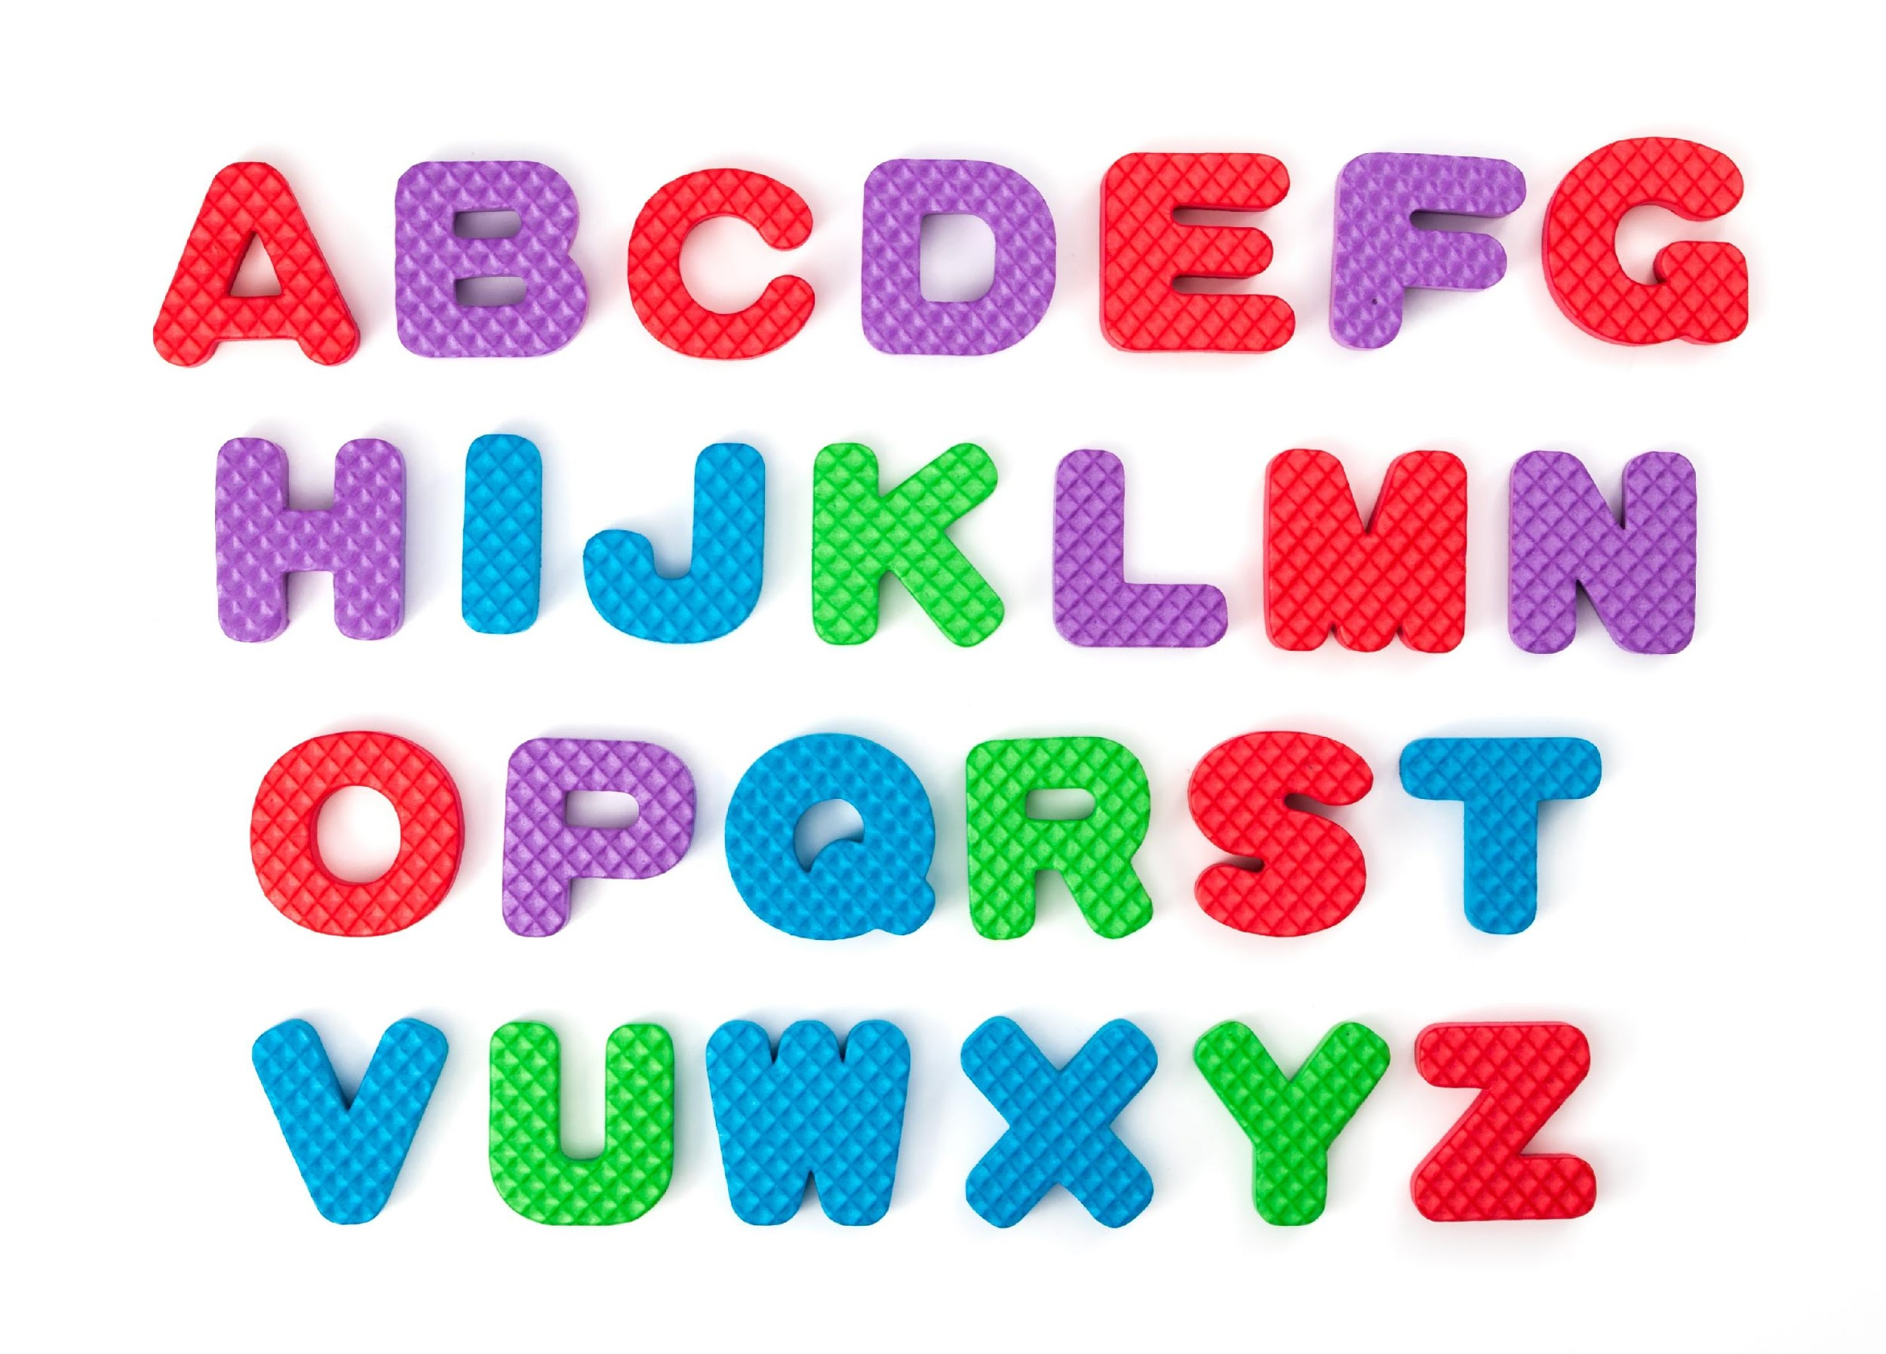
Alphabet Knowledge
This week, let’s focus on the letter, “O”. As you move throughout the house look for things that have the letter O in it. See if can find some cheerios, oreos, oranges, cookies, anything in the shape of a circle, etc.

Slide 20
Color Review
As you go through the day. Remember to ask the child, “What color is this?”
The Day the Crayon Quit
https://www.youtube.com/watch?v=ZttMDho5HMw
This Photo by Unknown Author is licensed under CC BY-NC-ND

Slide 21
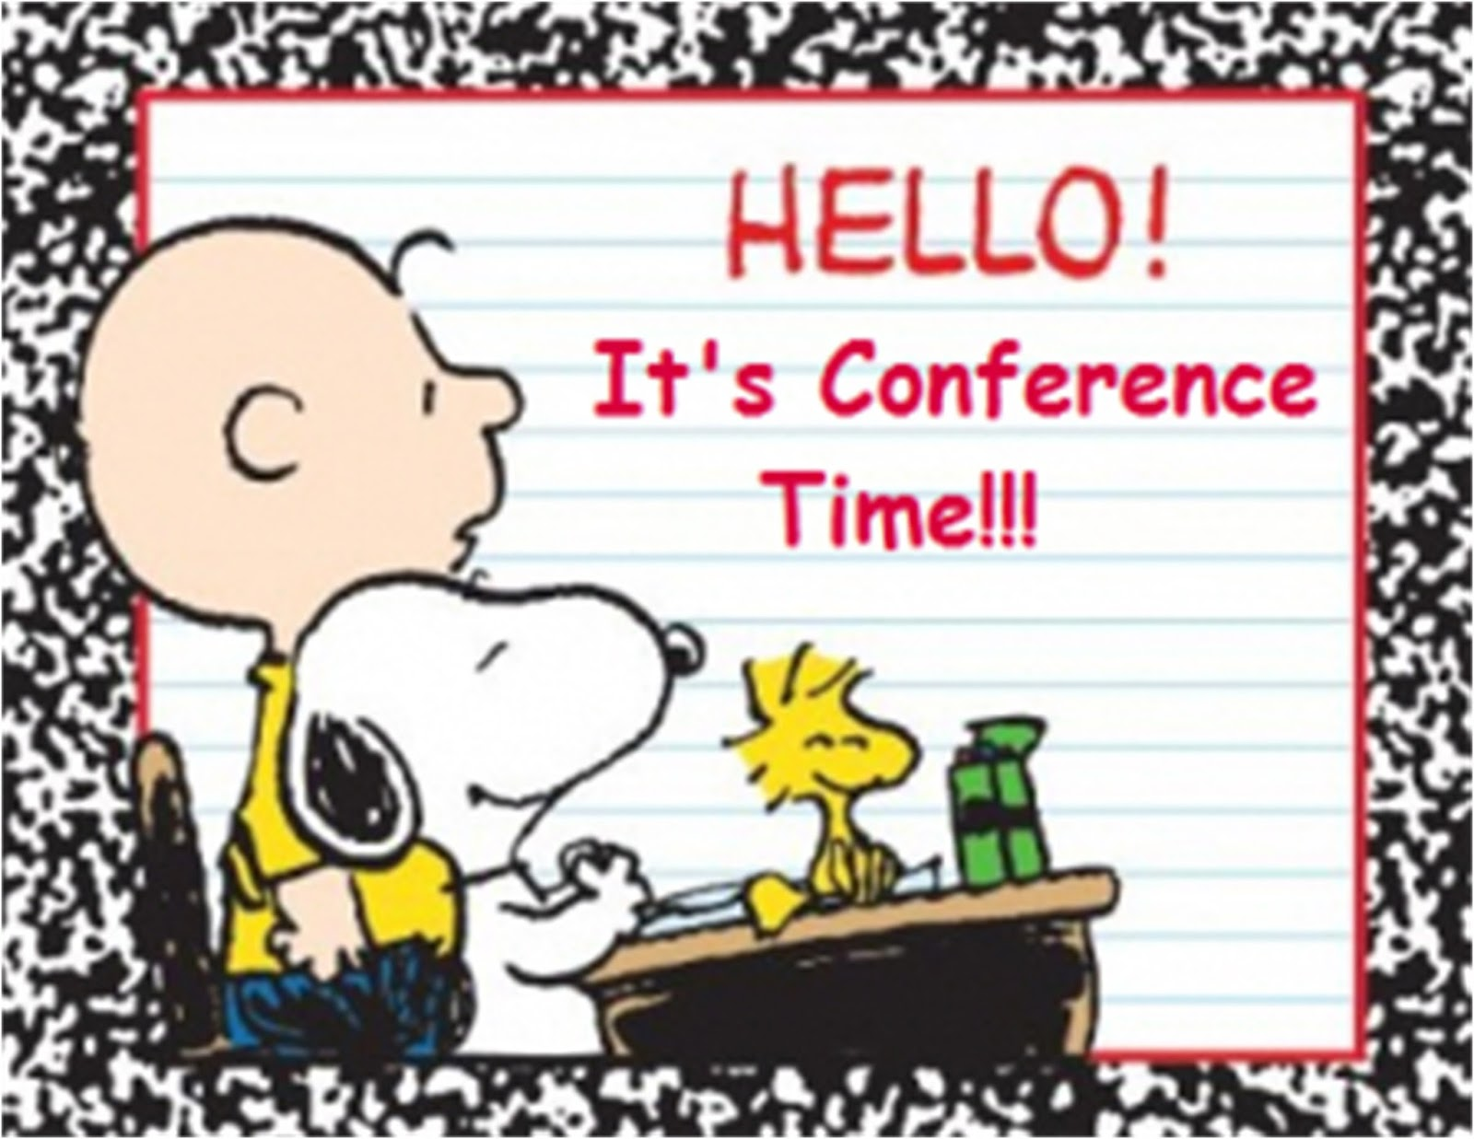
Table Talk
How are you doing?
How do you feel about your child returning to school?
Is there anything we can help you with?

Slide 22
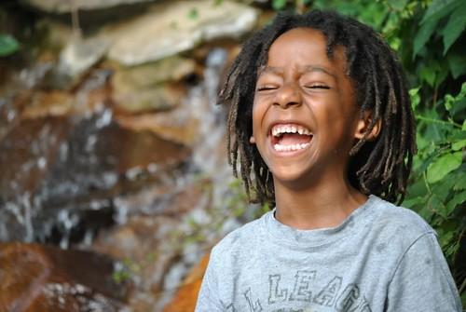
References
https://www.youtube.com/watch?v=ZttMDho5HMw
https://www.youtube.com/watch?v=ir4PF70GYQU

